Slide 1
CMPT384-2019-Team 19
Luohan Du
Xudong Li

Slide 2
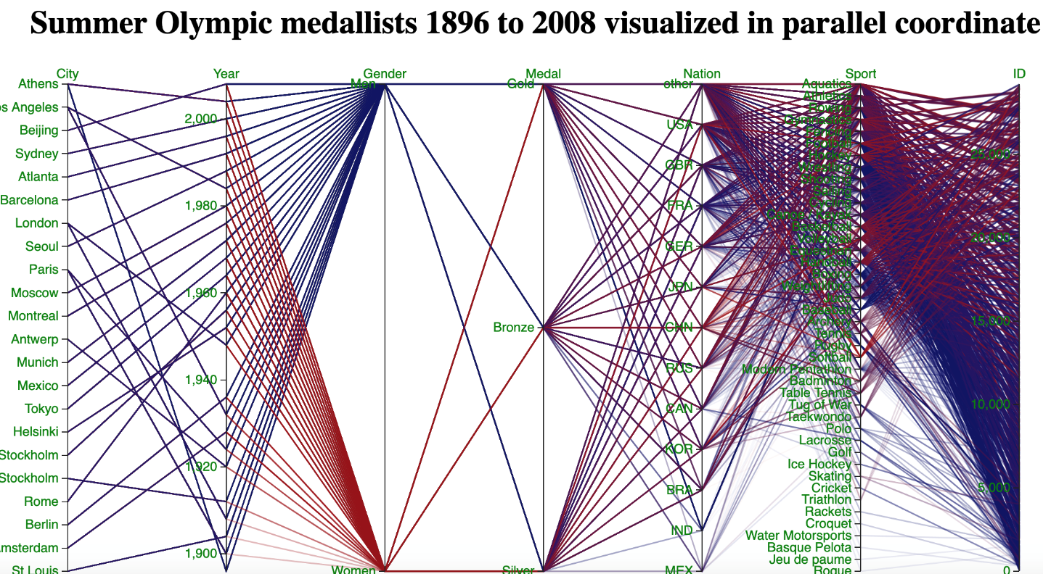
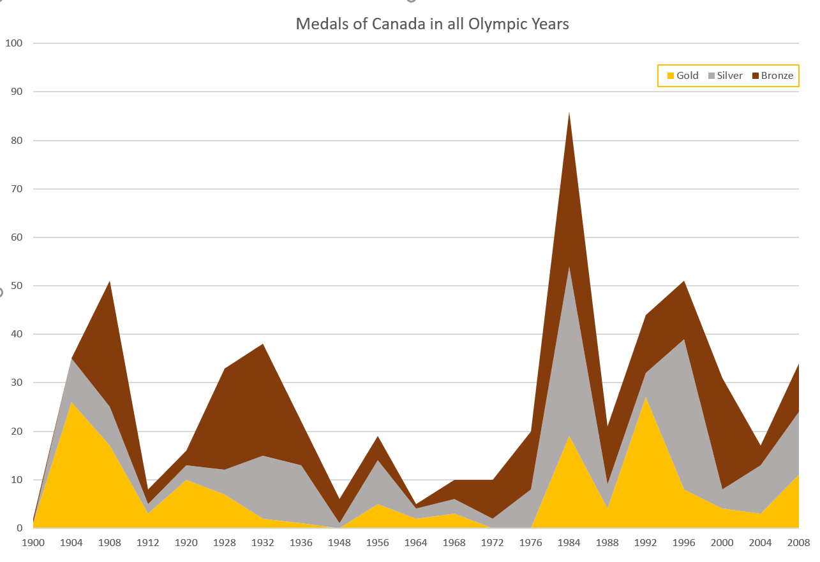
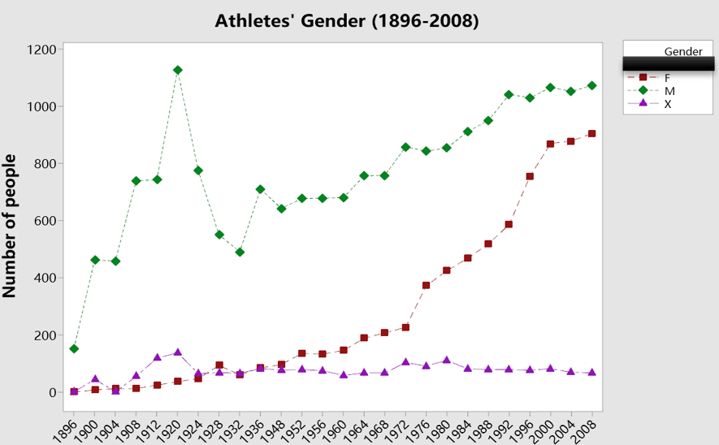
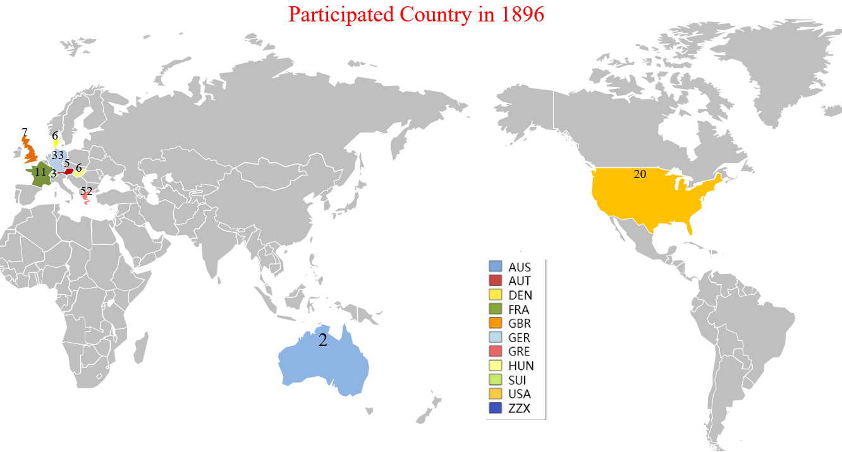
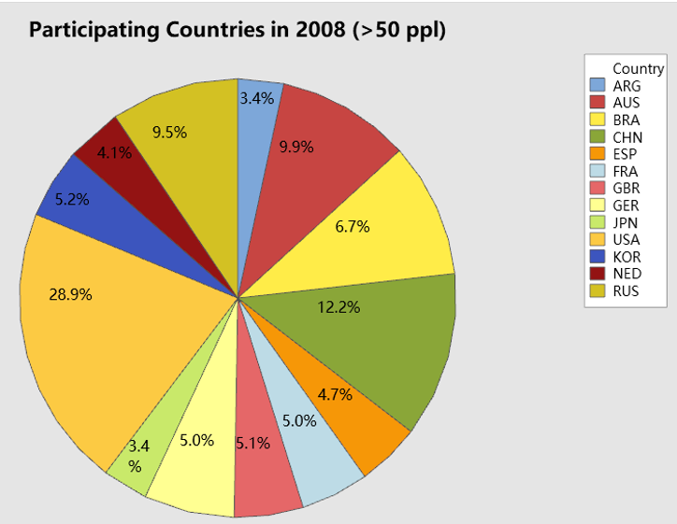
Dashboard

Slide 3
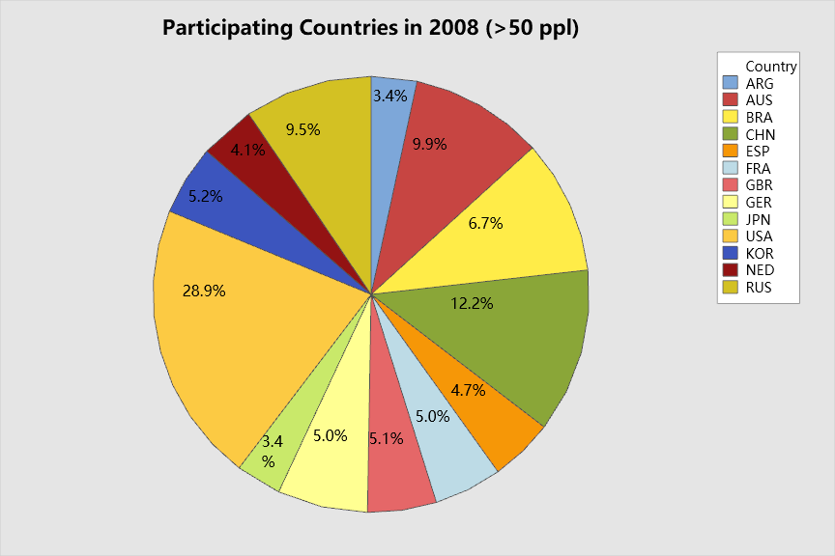
Qusetion1:
Which country had the most athletes participated the Olympic Games in 2008?
Answer:
A pie chart shown above describes percentage of each country which has at least 50 athletes.
According to the chart, USA has the largest percentage of athletes in the Olympic Games in 2008( approximately 29%).

Slide 4
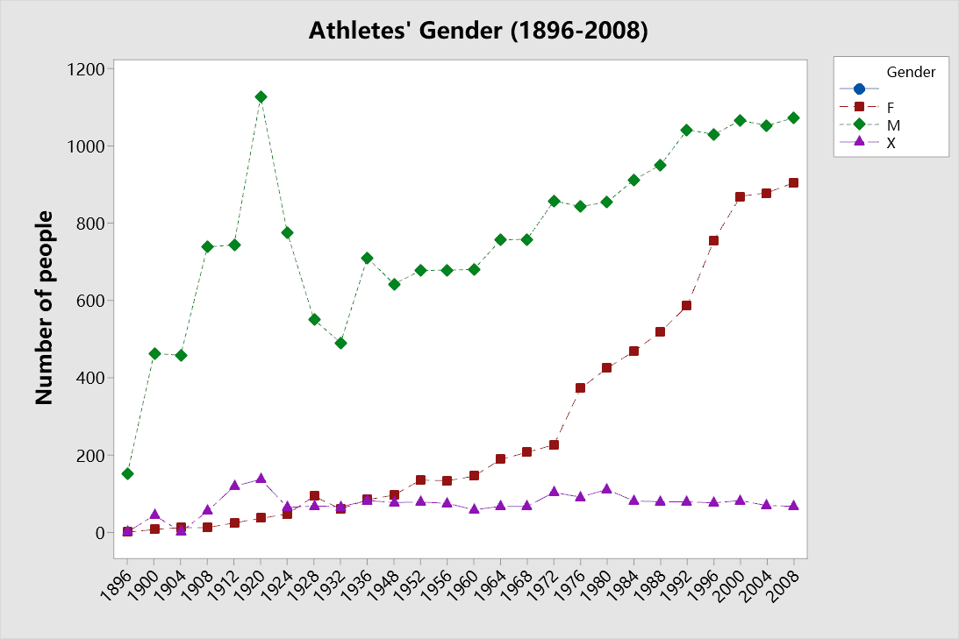
Qusetion2:
In the history of the Olympics, what is the trend in the number of female athletes comparing with male athletes?
Answer:
A line chart shown above describes the changes of the number of male, female and unspecified athletes in all years of the Olympics.
As we can see that the amount of female athletes is much lower than female athletes but increasing steadily before 1972. Since 1976, this number rises sharply and the gap between male and female athletes becomes less and less. The number of female athletes reaches the peak in 2008.

Slide 5
Qusetion3:
Which kind of medals is the dominant part of the total medals of Canada in each Olympic year?
Answer:
An area chart shown left describ-es total medals of Canada in each of the Olympic years.
As we all know that a stacked area chart shows how much each part contributes to the whole amount. Therefore, to find the dominant part of the total medals , we could compare the area of each part to other part.

Slide 6
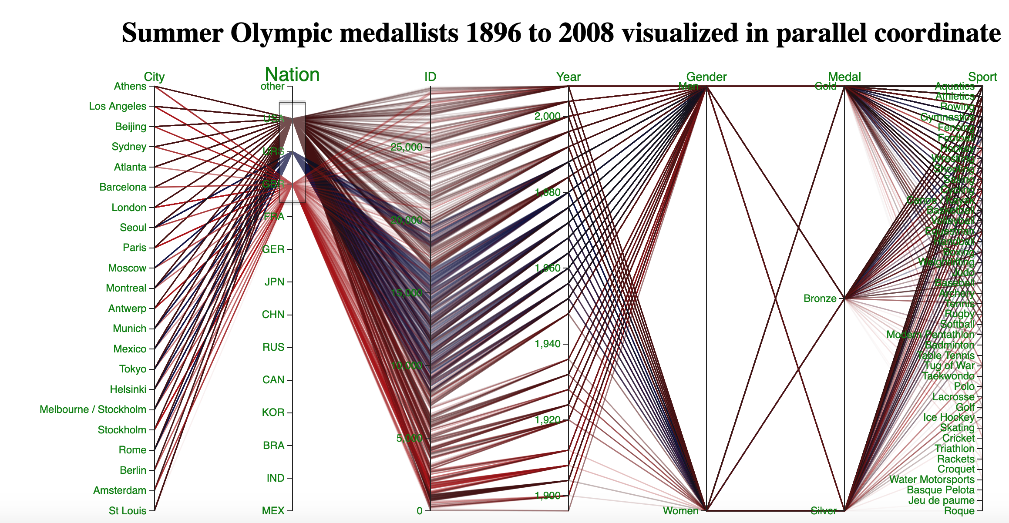
Parallel coordinate can help us solve many Questions. I can give a specific question here: which nation’s athletes among USA, UK and USSR get the most medals in Olympic games? Here, we can use the brushing to find out that American athletes get the most medals. We also can get more information here, like UK get the most medals in 1908 Olympic game. We can also find out that USSR start to catch up the USA in late 40s‘

